Slide 1
Face Anti-Spoofing
BTech Project Presentation
By: Tadi Dinesh Kumar Reddy (200001075)
Under supervision of: Dr. Surya Prakash

Slide 2
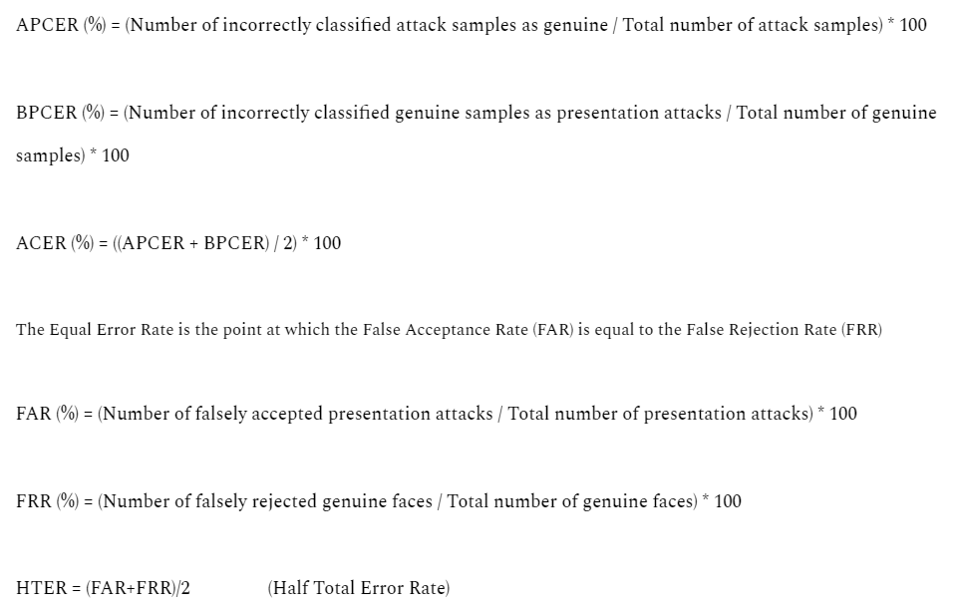
Metrics used for Face Anti-Spoofing

Slide 3
Searching Central Difference Convolutional Networks for Face Anti-Spoofing
Official implementation:
https://github.com/ZitongYu/CDCN/tree/master
OULU-NPU, SiW, CASIA-MFSD, Replay-Attack, MSU-MFSD and SiW-M datasets used
Unofficial:
https://github.com/laoshiwei/face-anti-spoofing
Uses NUAA dataset (~400mb)
Paper:
https://openaccess.thecvf.com/content_CVPR_2020/papers/Yu_Searching_Central_Difference_Convolutional_Networks_for_Face_Anti-Spoofing_CVPR_2020_paper.pdf

Slide 4
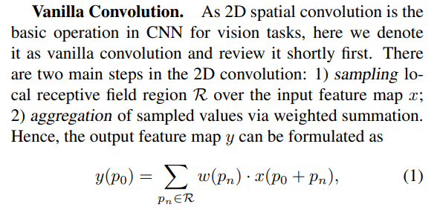
Searching Central Difference Convolutional Networks for Face Anti-Spoofing
A convolution operator called Central Difference Convolution (CDC) has been proposed in this paper, CDC is more likely to extract intrinsic spoofing patterns (e.g.,lattice artifacts) than vanilla convolution in diverse environments.

Slide 5
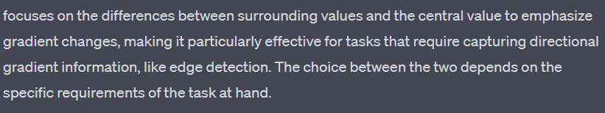
Searching Central Difference Convolutional Networks for Face Anti-Spoofing
CDC prefers to aggregate center-oriented gradients of the sampled values. The center-oriented gradient refers to the difference between the central value of the sampled region and the average of the surrounding values. This difference emphasizes the gradient changes that are centered around the current position. Aggregating these center-oriented gradients rather than the raw values allows the convolution to be more sensitive to changes in the center of the receptive field.

Slide 6
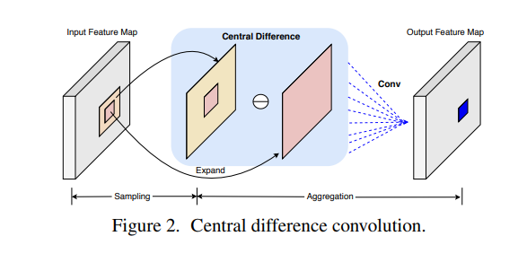
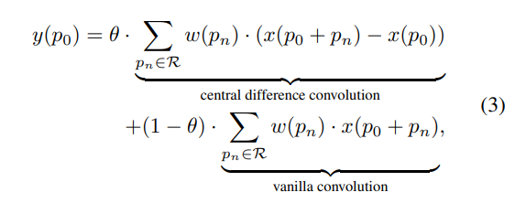
Searching Central Difference Convolutional Networks for Face Anti-Spoofing
CDC implementation:
For face anti-spoofing task,
both the intensity-level semantic info,
gradient-level detailed info are
crucial for distinguishing
the living and spoofing faces
So, a more generalized formula would be

Slide 7
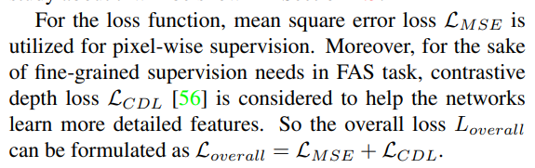
Searching Central Difference Convolutional Networks for Face Anti-Spoofing
A depth-supervised network called “DepthNet” is built up as baseline in this paper.
In order to extract more fine-grained and robust features for estimating the facial depth map, CDC is introduced to form Central Difference Convolutional Networks (CDCN).
Further, CDCN++ is also proposed, which consists of a NAS based backbone and Multiscale Attention Fusion Module (MAFM) with selective attention capacity.

Slide 8
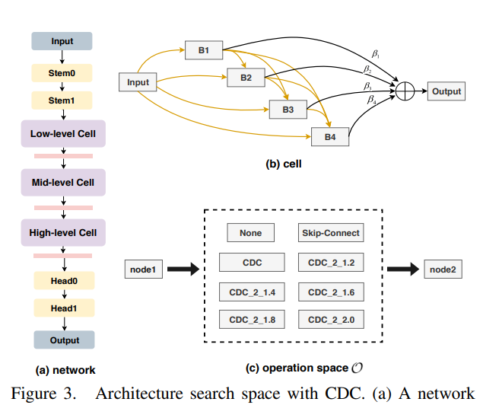
Searching Central Difference Convolutional Networks for Face Anti-Spoofing
NAS (Neural Architecture Search)
Two gradient-based NAS methods were used
to search for the best backbone for the model

Slide 9
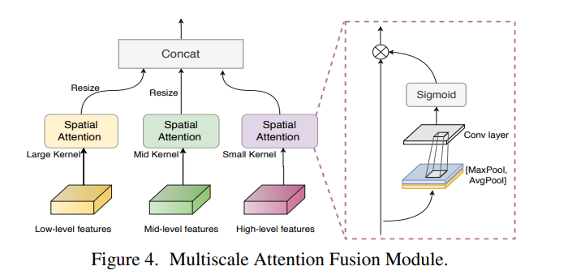
Searching Central Difference Convolutional Networks for Face Anti-Spoofing
Although simply fusing low-mid-high levels features can boost performance for the searched CDC architecture, it is still hard to find the important regions to focus.
So, a Multiscale Attention Fusion Module (MAFM) is proposed, which is able to refine and fuse low-mid-high levels CDC features via spatial attention

Slide 10
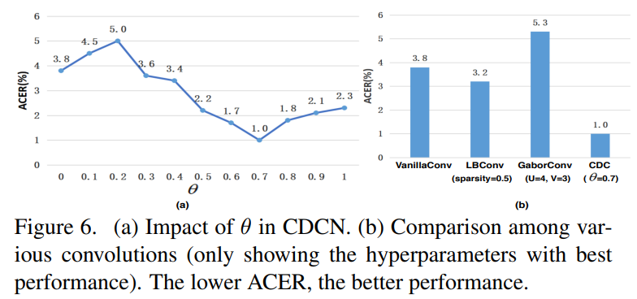
Searching Central Difference Convolutional Networks for Face Anti-Spoofing
Performance metrics showing CDC performs better than Vanilla

Slide 11
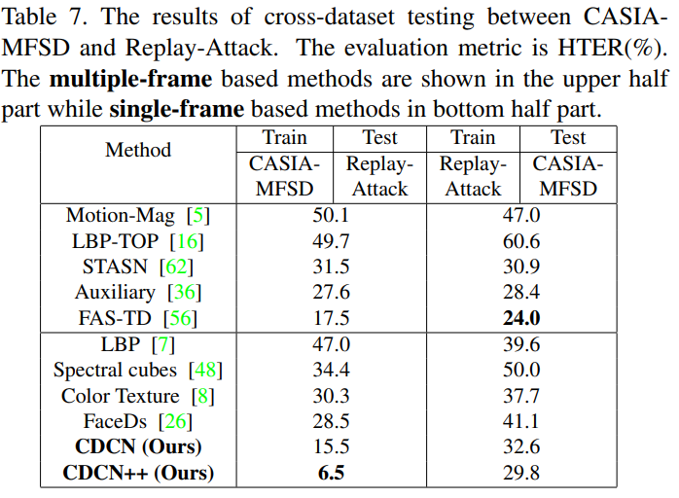
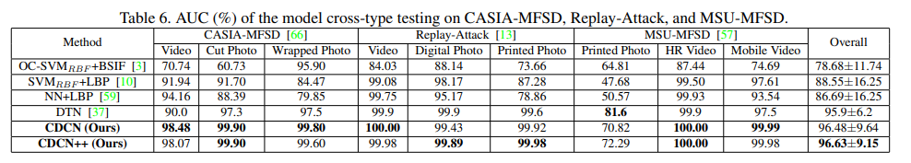
Searching Central Difference Convolutional Networks for Face Anti-Spoofing
Performance metrics

Slide 12
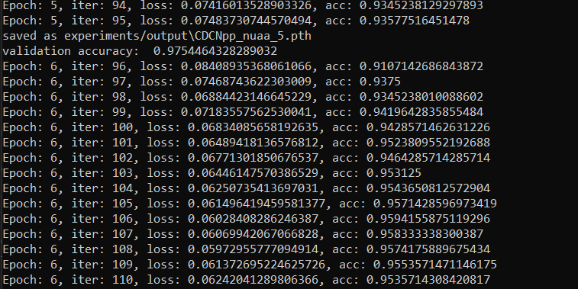
Searching Central Difference Convolutional Networks for Face Anti-Spoofing
Unofficial implementation: Using subset of NUAA dataset (~250 genuine, 614 fake)

Slide 13
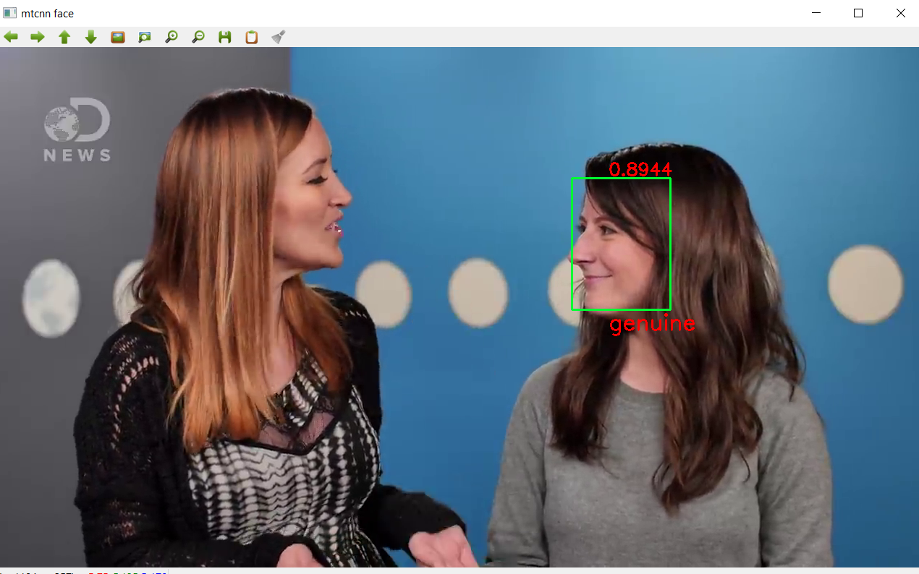
Searching Central Difference Convolutional Networks for Face Anti-Spoofing
Unofficial implementation: Inference (incomplete code)
Image reference: https://github.com/laoshiwei/face-anti-spoofing/blob/main/face.mp4

Slide 14
Deep Pixel-wise Binary Supervision for Face Presentation Attack Detection
Official implementation:
https://gitlab.idiap.ch/bob/bob.paper.deep_pix_bis_pad.icb2019
Uses BOB software
Replay-Mobile and OULU-NPU datasets were used
Unofficial:
https://github.com/Saiyam26/Face-Anti-Spoofing-using-DeePixBiS
Uses NUAA dataset (~400mb)
Paper:
https://arxiv.org/pdf/1907.04047v1.pdf

Slide 15
Deep Pixel-wise Binary Supervision for Face Presentation Attack Detection
A frame level CNN based framework is proposed for PAD, which is suitable for practical deployment scenarios since it requires only frames instead of video.
Pixel-wise binary supervision is proposed which simplifies the problem and obviates the requirement for video samples and synthesis of depth maps.
The proposed framework uses a densely connected neural network trained using both binary and pixel-wise binary supervision (DeepPixBiS).
Both binary and pixel-wise binary supervision is used by adding a fully connected layer on top of the pixel-wise map.

Slide 16
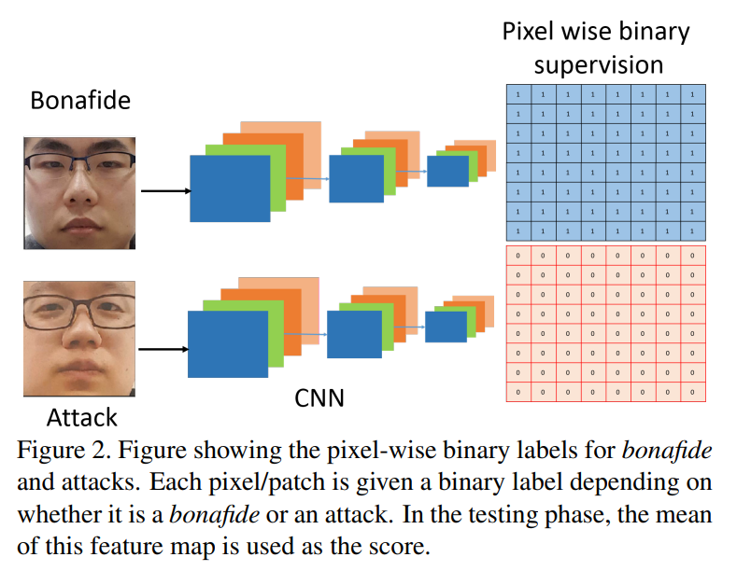
Deep Pixel-wise Binary Supervision for Face Presentation Attack Detection

Slide 17
Deep Pixel-wise Binary Supervision for Face Presentation Attack Detection
In the case of 2D attacks, all patches are considered to have the same label.
This helps remove the need to separately compute the depth maps during training.
Thus, instead of using synthesized depth values for pixel-wise supervision, the paper uses pixel-wise binary supervision.
The pixel-wise supervision forces the network to learn features which are shared, thus minimizing the number of learnable parameters significantly.

Slide 18
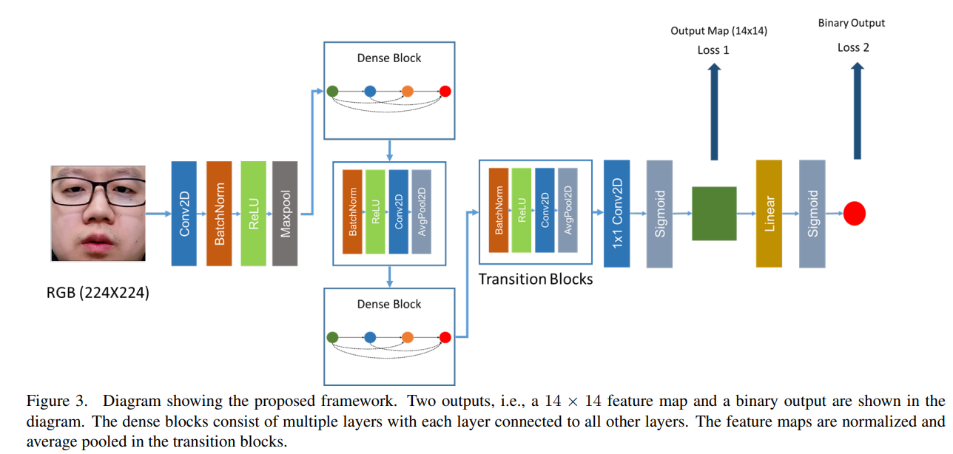
Deep Pixel-wise Binary Supervision for Face Presentation Attack Detection

Slide 19
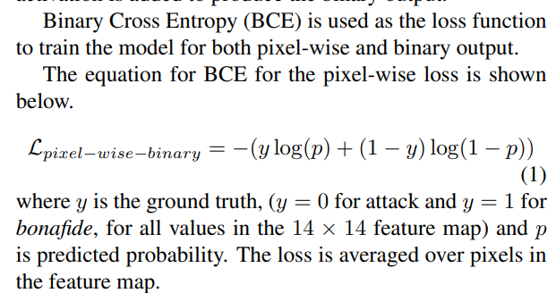
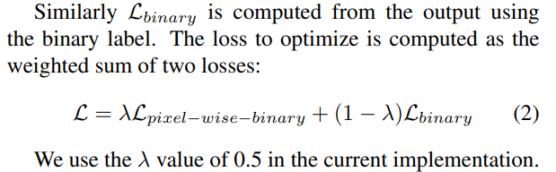
Deep Pixel-wise Binary Supervision for Face Presentation Attack Detection
Binary loss (Bona fide or PA)
Loss 2 in architecture shown
Pixel-wise-binary loss (depth loss)
Loss 1 in architecture shown

Slide 20
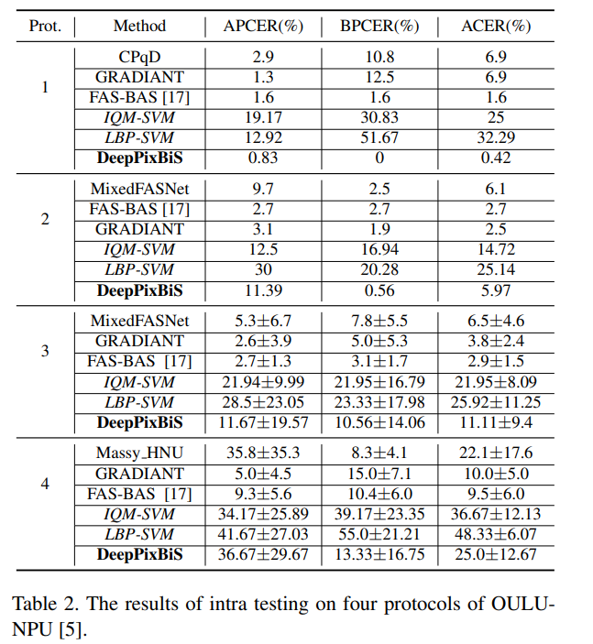
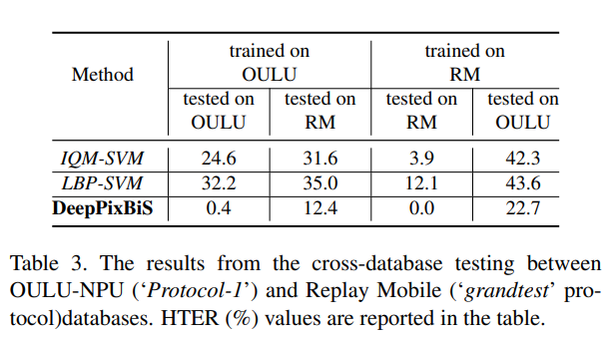
Deep Pixel-wise Binary Supervision for Face Presentation Attack Detection
Performance metrics
The performance in ‘Protocol-4’ is the worst,
which consists of unseen PAI & environments.

Slide 21
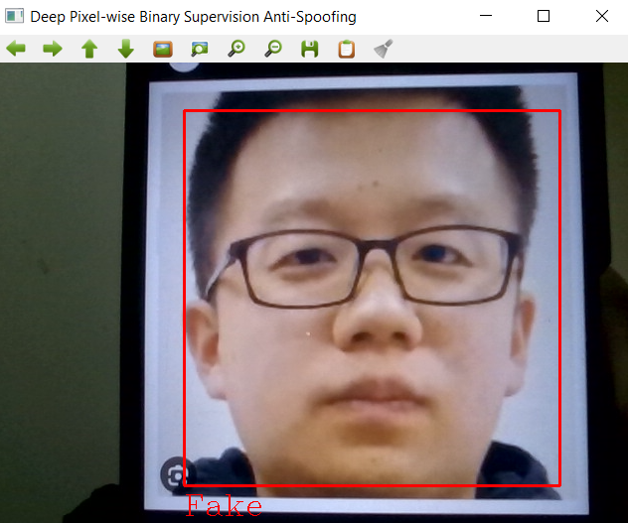
Deep Pixel-wise Binary Supervision for Face Presentation Attack Detection
Unofficial implementation:
Using NUAA dataset
(has implementation for testing
using cam (useful for inference))

Slide 22
References
Links
https://github.com/ZitongYu/CDCN/tree/master
https://github.com/laoshiwei/face-anti-spoofing
https://gitlab.idiap.ch/bob/bob.paper.deep_pix_bis_pad.icb2019
https://github.com/Saiyam26/Face-Anti-Spoofing-using-DeePixBiS
https://arxiv.org/pdf/1907.04047v1.pdf
https://openaccess.thecvf.com/content_CVPR_2020/papers/Yu_Searching_Central_Difference_Convolutional_Networks_for_Face_Anti-Spoofing_CVPR_2020_paper.pdf
http://parnec.nuaa.edu.cn/_upload/tpl/02/db/731/template731/pages/xtan/NUAAImposterDB_download.html

Slide 23
References
Papers
Yu, Zitong, et al. "Searching central difference convolutional networks for face anti-spoofing." Proceedings of the IEEE/CVF Conference on Computer Vision and Pattern Recognition. 2020.
George, Anjith, and Sébastien Marcel. "Deep pixel-wise binary supervision for face presentation attack detection." 2019 International Conference on Biometrics (ICB). IEEE, 2019.
Xiaoyang Tan, Yi Li, Jun Liu, and Lin Jiang. 2010. Face liveness detection from a single image with sparse low rank bilinear discriminative model. In European Conference on Computer Vision. Springer, 504–517.

